Slide 1
your AmeriCorps Education Award
Updated 2018

Slide 2
The Segal AmeriCorps Education Award
Also called “AmeriCorps Education Award” and “Ed Award;”
Awarded post-service to AmeriCorps and VISTA alums who successfully complete their service;
Amount is variable, pegged with the Pell grant, currently the Summer Associate Award and 300 hr. AmeriCorps Ed Award is: $1212.44. (The full Award is $5920, 900 hr. $2887.50, 675 hr. $2200);
Is a voucher, good for seven years after it is issued, held in trust by the federal government in your name;

Slide 3
The Segal AmeriCorps Education Award
Can be used for current costs of attendance at qualifying (i.e. Title IV funds) institutions;
Can be used to pay back qualifying student loans (i.e. subsidized loans);
Both monthly payments and loan principal.
Can be used for international study, continuing ed., non-credit courses;
Is matched by thirteen Montana colleges and universities (info later) and dozens more around the country;

Slide 4
How do I use it?
Log into your MyAmeriCorps portal and go into the Education Award interface;
Select the college/university or loan holder you’d like to send funds to (if they’re not listed, there is an add vendor feature);
Add the amount of the payment you’d like to make;
Confirm that you’ve selected the correct amount and recipient, and finalize.
Confirm payment has arrived with the financial aid folks or loan holder whom you’re sending the payment.

Slide 5
What about taxes?
The Education Award is taxable in the year it is used;
Taxes are not withheld by the National Service trust;
Taxes are not withheld by the National Service trust;
It is your responsibility to predict what the tax implications will be in the year you use it and plan accordingly.
It is your responsibility to predict what the tax implications will be in the year you use it and plan accordingly.

Slide 6
So, that’s a lot to think about. How are you doing?

Slide 7
Taxes continued
To learn about what the implications of using the Ed Award are on your tax burden, consult a tax table, an accountant, or other resource before using your Education Award;
Before using your Education Award.
A common practice to minimize tax burden seems to be spreading payments across multiple tax years, e.g. $2000 in 2018, $2000 more in 2019, etc.

Slide 8
Other match strategies
Check the nationalservice.gov website for “Matching Institutions.” https://www.nationalservice.gov/programs/...education-award/matching-institutions
If the college or university you’re interested in attending is not on that list you should negotiate. Let the department you’re coming to, or the admissions office know you’re an AmeriCorps or VISTA alum and would like them to match your Ed Award.
Strategies:
Familiarize with another, similar institution’s match and let them know what the competition does, and that’s what you’d like them to do.
Use terms like “tuition waiver” “discount” or “scholarship” to clarify the concept, if they’re not clear exactly what you’re asking for.

Slide 9
Education Award resources
Nationalservice.gov
Specifically: http://www.nationalservice.gov/resources/edaward
VISTA campus has good information https://www.vistacampus.gov/after-vista/education ;
Fafsa.ed.gov has a list of foreign institutions that accept Title IV funding;
Others that you know of?

Slide 10
Where do I go with my questions?
Nationalservice.gov has some excellent FAQs, tools and resources;
The National Service Trust Hotline
Can answer many questions about AmeriCorps education benefits: Telephone 800-942-2677.
Questions may also be submitted at the National Service Hotline's Ask a Question page:

Slide 11
Other notes:
Montana Campus Compact: Montana’s affiliate of the national network, started matching Ed Awards in 2016
=

Slide 12
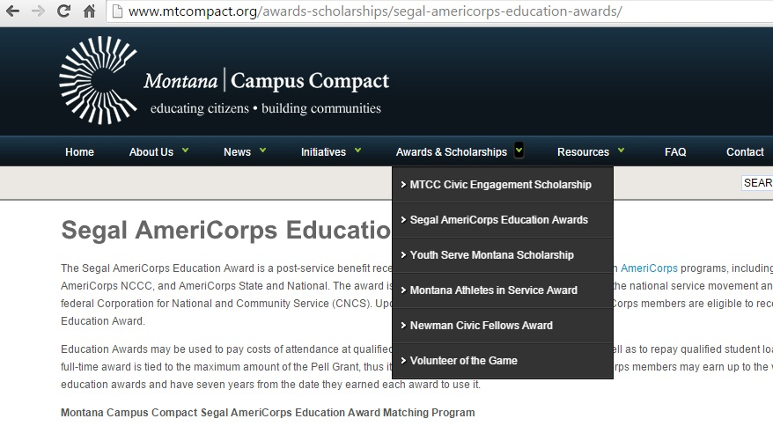
What Does That Mean?
Right now, thirteen campuses, including public, private, tribal, two-year, four-year and graduate programs are officially registered offering a minimum of $1000 in match.
Listed at mtcompact.org under the “Awards and Scholarships” tab, “Segal AmeriCorps Education Award”

Slide 13
Some notes:
Campus matches are for current costs of attendance, not paying back loans. Each campus has a different capacity for offering matches, deadlines, and process for applying. Some are much more limited than others.
Members need to meet with campus financial aid to initiate the match. It won’t happen automatically.
Please all MTCC if you have difficulty.

Slide 14
Additionally
Montana has a great set of postsecondary education options, including our “embedded” two-year campuses, which offer high quality, competitively priced courses, degrees and certificates.

Slide 15
Other:
If you’re planning to work in public service, consider applying for the Public Service Loan Forgiveness program.
Synopsis: The Public Service Loan Forgiveness (PSLF) Program forgives the remaining balance on your Direct Loans after you have made 120 qualifying monthly payments under a qualifying repayment plan while working full-time for a qualifying employer.
Info: https://studentaid.ed.gov/sa/repay-loans/forgiveness-cancellation/public-service

Slide 16
Questions?
Thank you!
Josh Vanek
Montana Campus Compact mtcompact.org
406-243-5175
vanek@mtcompact.org

